Slide 1
New Insulin Analogs: Update on Insulin Use in T2DM
Professor Ilhan SATMAN, MD
Istanbul University - Istanbul Faculty of Medicine
DIMER DIABETES 2024
21-23 November 2024, Hyatt Regency Hotel, Ataköy, Istanbul

Slide 2
I have no conflict of interest regarding to this presentation.

Slide 3
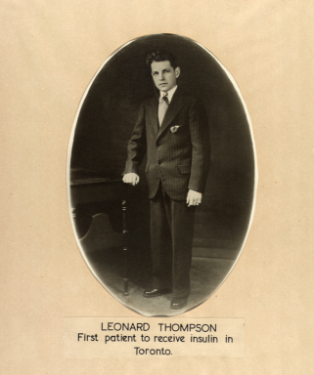
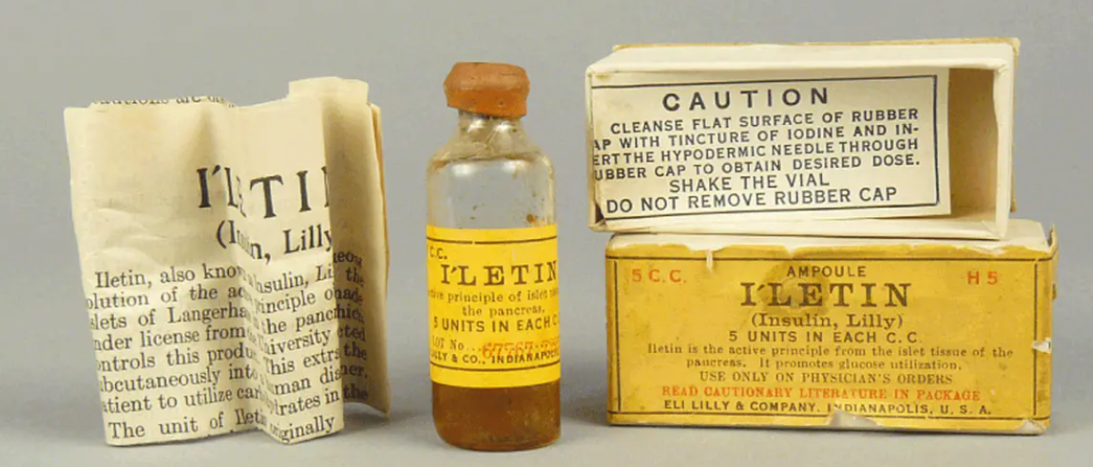
On Jan 11, 1922, 14-year-old Leonard Thompson became the first person to receive an insulin injection as a treatment for diabetes. Prior to that, people with type 1 diabetes did not survive for more than a few weeks or months with the disease.

Slide 4
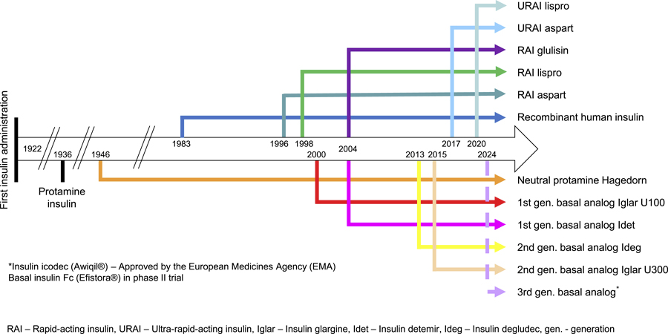
Timeline of the development of new generations of different insulin preparations
Current and Future Strategies in Insulin Development and Treatment. Horm Res Paediatr. Published online July 24, 2024.1-9 doi:10.1159/000540424.
Date of Download: 9/14/2024
Copyright © 2024 Karger Publishers. All rights reserved.
Notes:
Figure Legend: Timeline of the development of new generations of different insulin preparations.

Slide 5
Specific clinical conditions
PTDM (pre-existing or PTx)
Pregnancy (pre-existing T2DM or GDM)
High HbA1c
>8.5% at Dx
>7% (persisting)
Increased HbA1c with others
Prolonged treatment with corticosteroids
INDICATIONS FOR INSULIN THERAPY IN T2DM
Intolerance to other anti-hyperglycemic agents
Hospitalization
ICU/conventional
Regardless of nutriton pathway
Insulinopenic phenotypes
Comorbidities
Advanced CKD/Dialysis
ICU/conventional
Regardless of nutrition pathway
Decompensation
Hypoglycemia
NKHS
DKA
Sanz-Pastor, et al. Current barriers to initiating insulin therapy in individuals with type 2 diabetes.Front. Endocrinol. 15:1366368. doi: 10.3389/fendo.2024.1366368

Slide 6
Harmful consequences of delayed initiation of insulin therapy and undertreatment of hyperglycaemia
Increased risk of diabetes-related complications
Progressive deficit in β-cell mass and function
Promoted sarcopenia and dizziness
Reduced physical and mental fitness
Reduced resistance against infections
Reduced libido and sexual potency
In elderly, risk of nycturia and incontinence
Higher dosage of insulin needed with higher risk of severe hypoglycaemia

Slide 7
Barriers to initiate insulin therapy in T2DM and potential solutions
Factor | Barrier | Strategy
Patient | Adherence Perception of failure | Long-acting insulin Dose reminding systems Diabetes education programs
Social environment | Social rejection | Health literacy
Treatment | Dosages Hypoglycemia Administration method Weight gain | Simple adjustment guidelines Implementation of FGM/CGM systems Documention of hypos Monitoring (SMBG, FGM/CGM) Patient education on hypos Adjustment of physical exercise Guideline instructions on hypo thr. Simple devise, smart pens Tools for needle phobiers Medical nutrition thr. Regular physical exercise Rational selection of insulin and OHAs
Professional | Experience of diabetes team | Education of educators Regular review of diabetes control Using technology Avoiding of inertia to start insulin Considering of special situations (pregnancy, steroids, ...)
Sanz-Pastor, et al. Current barriers to initiating insulin therapy in individuals with type 2 diabetes.Front. Endocrinol. 15:1366368. doi: 10.3389/fendo.2024.1366368
Notes:
Haftalık bazal insülinler ile;
Daha az enjeksiyon ile tedavi yükünün azaltılması,
Doz atlama, sürekli aynı bölgeye enjeksiyon gibi uygulama hatalarının önlenmesi,
Unutulan, atlanan dozlarda kararlı (steady state) durumun sürmesine olanak veren doz esnekliği sağlanması,
Hipo- ve hiperglisemilerin azaltılması,
Tip 2 diyabetli bireylerde hipoglisemilerin azaltılması,
Yaşlı, bakım evlerinde kalan veya yalnız yaşayan bireylerin haftalık uygulama ile daha stabil kan glukoz seviyelerine ulaşması,

Slide 8
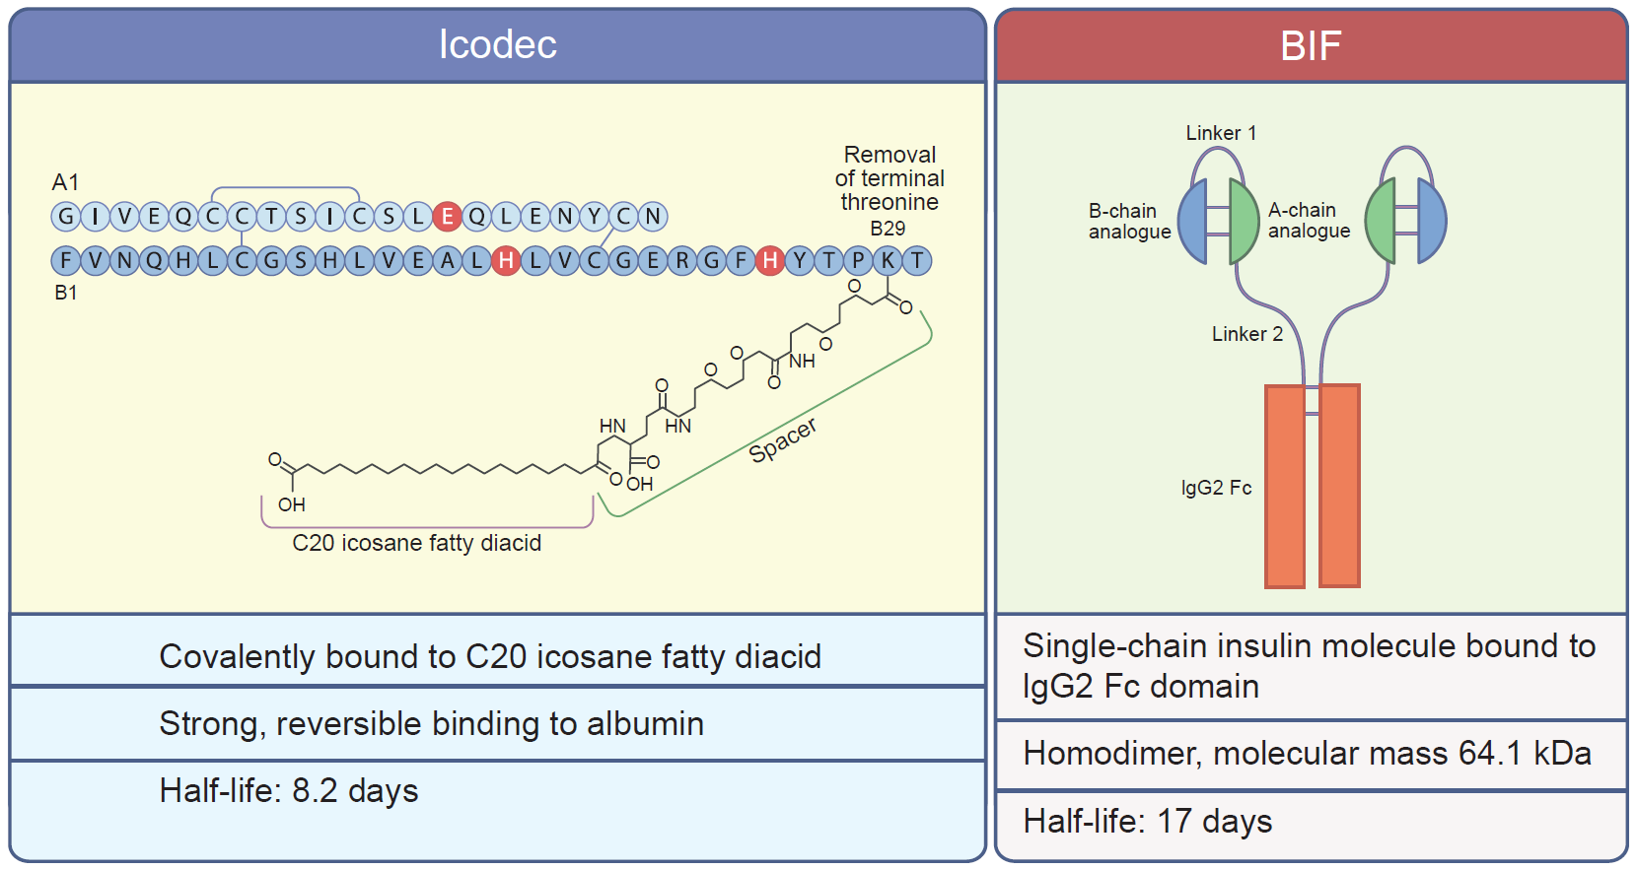
Molecular and pharmacokinetic features of insulin icodec (Awiqli) and basal insulin Fc (BIF; insulin efsitora alfa)
Trevisan, et al. Once-weekly insulins: a promising approach to reduce the treatment burden in people with diabetes. Diabetologia. 2024;67(8):1480-92. doi: 10.1007/s00125-024-06158-9.
Notes:
Icodec molekülü üç aminoasit sübstitüsyonu ve Degludec'e benzer şekilde bir C20 ikosan yağ diasidine bağlanmıştır.
Amino asit değişimleri enzimatik bozunmayı azaltmayı, insülin reseptörüne afiniteyi azaltmayı (dolayısıyla insülin reseptörü-aracılı klirensi azaltmayı) ve çözünürlüğü iyileştirmeyi amaçlamaktadır.
Öte yandan yağ asidi molekülü, albümine güçlü, non-kovalent ve geri dönüşümlü bağlanmaya izin verir, böylece insülin moleküllerinin sürekli ve yavaşça salındığı inaktif bir dolaşım deposu oluşturur.
Bazal insülin Fc (BIF) ya da insülin Efsitora-alfa, üretimi IgG-Fc füzyon teknolojisine dayanmaktadır.
Tek zincirli insülin moleküllerinden oluşan homodimer, insan IgG2'sinin Fc kısmı ile kovalent bağlanır.
IgG'ler, albümin ile birlikte, en uzun yarı ömre sahip plazma proteinleridir (yaklaşık 20 gün).
Birkaç amino asit sübstitüsyonu, insülinin kendi kendine birleşmesini minimize eder, kimyasal ve fiziksel stabilite sağlar ve insülin reseptör afinitesini azaltır.
Hem sıçanlarda hem de insanlarda 17 günlük yarılanma ömrü ve neredeyse düz bir profil ile doz-cevap eğrisi olduğu gösterilmiştir.

Slide 9
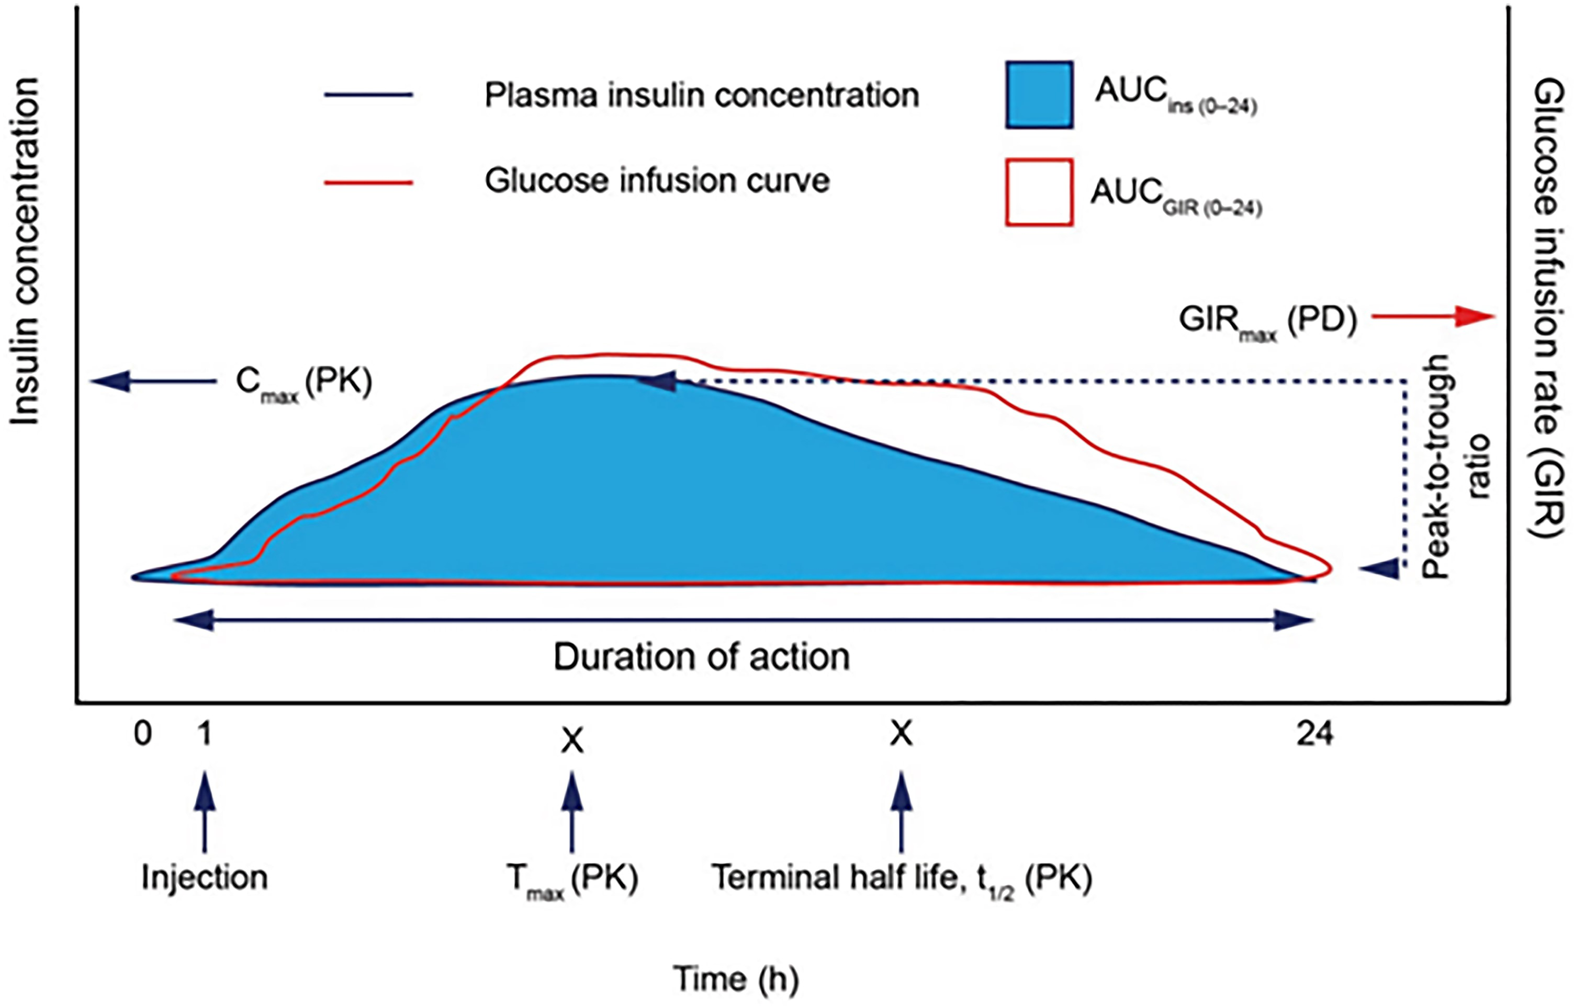
Insulin pharmacokinetics. Schematic PK/PD profile for basal insulin after administration of a single dose at steady state
Pieber, et al. Understanding the pharmacokinetics and glucodynamics of once weekly basal insulins to inform dosing principles: an introduction to clinicians. Endocr Pract. 2024;30(9):863-9 doi: 10.1016/j.eprac.2024.06.007.
Notes:
Figure 1. Insulin pharmacokinetics. Schematic PK/PD profile for basal insulin after administration of a single dose after maintenance phase (steady state) has been achieved highlighting key PK/PD parameters. P/T ratio: difference between the highest and lowest concentration of injected insulin at steady state; and t1/2: the time it takes for 50% of the drug to be eliminated relative to the Cmax. AUC, area under the curve; Cmax, peak insulin concentration reached; GIR, glucose infusion rate; GIRmax, time of maximum glucose infusion rate; INS, insulin (analogue) concentration; PD, pharmacodynamic; PK, pharmacokinetic; Tmax, time when peak insulin concentration is reached. Reproduced with permission from Heise and Meneghini (9). Pharmacokinetics are defined by insulin concentrations whereas glucodynamics are defined by the biological effect as assessed by glucose infusion rates required to maintain a stable glucose level over time (euglycemic insulin clamp). Note the right shift in the profile of glucodynamics as compared to pharmacokinetics. AUC, area under the curve; Cmax, peak insulin concentration; GD, glucodynamic; GIR, glucose infusion rate; GIRmax, maximum glucose infusion rate; PK, pharmacokinetic; P/T, peak-to-trough ratio.(3. Moyers JS, Hansen RJ, Day JW, Dickinson CD, Zhang C, Ruan X, Ding L, Brown RM, Baker HE, Beals JM. Preclinical Characterization of LY3209590, a Novel Weekly Basal Insulin Fc-Fusion Protein. J Pharmacol Exp Ther. 2022;382(3):346-55. doi: 10.1124/jpet.122.001105).

Slide 10
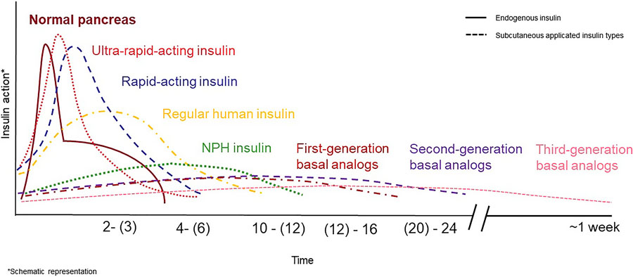
Duration of action of insulin preparations
Current and Future Strategies in Insulin Development and Treatment. Horm Res Paediatr. Published online July 24, 2024.1-9 doi:10.1159/000540424.
Date of Download: 9/14/2024
Copyright © 2024 Karger Publishers. All rights reserved.
Notes:
Bu slaytta, günde bir kez uygulanan bazal insülinlere kıyasla, haftada bir uygulanan bazal insülinin daha düz bir farmakokinetik profili olduğu, enjeksiyondan enjeksiyona değişkenliğinin daha düşük olduğu ve hastaya verdiği enjeksiyon yükünün daha az olduğu görülmektedir.
Icodec (Awiqli) Avrupa Birliği, Kanada, Avusturalya, Japonya ve İsviçre'de tip 1 ve tip 2 diyabetin; Çin'de ise tip 2 diyabetin tedavisi için onay almıştır.

Slide 11
HbA1c percent change from baseline reported in ONWARDS trials
Insulin naive T2D |  |  | Insulin treated T2D
ONWARDS 1 | ONWARDS 3 | ONWARDS 5 | ONWARDS 2 | ONWARDS 4
Icodec vs. Glargine U100 | Icodec vs. Degludec | Icodec vs. Basal insulin | Icodec vs. Degludec | Icodec vs. Glargine U100 + Aspart
Non-inferiority | p<0.001 | p<0.001 | p<0.001 | p<0.0001 | p<0.0001
Superiority | p=0.02 | p=0.02 | p=0.009 | p=0.028 | .......
Goldman , et al. A novel once-weekly basal insulin for diabetes management.
Ann Pharmacother. 2024:10600280241287790. doi: 10.1177/10600280241287790.

Slide 12
Efficacy and safety of once-weekly insulin icodec in type 2 diabetes: Meta-analysis of 5 ONWARDS phase 3 RCTs (n=3,764)
Once-weekly insulin icodec had higher HbA1c reduction [MD −0.17%, 95% CI (−0.28 to −0.06), p = 0.003], with no significant difference in FPG compared with other insulin analogues.
HbA1c achievement <7% [OR 1.51, 95% CI (1.14-1.99), p = 0.004] and HbA1c achievement <7% without hypoglycaemia [OR 1.45, 95% CI (1.26-1.67), p <0.00001] were higher in proportions with insulin icodec compared with the comparator group.
TIR was similar between insulin icodec and comparator [MD 2.42%, 95% CI (0.01-4.84), p = 0.05].
There was a higher incidence of level 1 hypoglycaemia with insulin icodec but similar for the incidence of levels 2, 3, and combined 2/3 hypoglycaemia.
Adverse events were similar in insulin icodec and comparators.
Insulin icodec had similar efficacy with insulin glargine U100 but superior efficacy with higher HbA1c reduction with insulin icodec compared with insulin degludec.
Safety profile was comparable to glargine U100, but insulin icodec reported higher incidence of hypoglycaemia events and adverse events than with degludec.
Shetty & Saluvarna. Efficacy and safety of once-weekly insulin icodec in type 2 diabetes: A meta-analysis of ONWARDS phase 3 randomized controlled trials. Diabetes Obes Metab. 2024;26(3):1069-81. doi: 10.1111/dom.15408.

Slide 13
Baseline characteristics of 4,317 patients with T2DM in 8 RCTs on insulin icodec*
*3 phase 2 and 5 phase 3 RCTs.
Dutta, et al. Optimal use of once weekly icodec insulin in type-2 diabetes: An updated meta-analysis of phase-2 and phase-3 randomized controlled trials. Diabetes Metab Syndr. 2023;17(10):102877. doi: 10.1016/j.dsx.2023.102877.

Slide 14
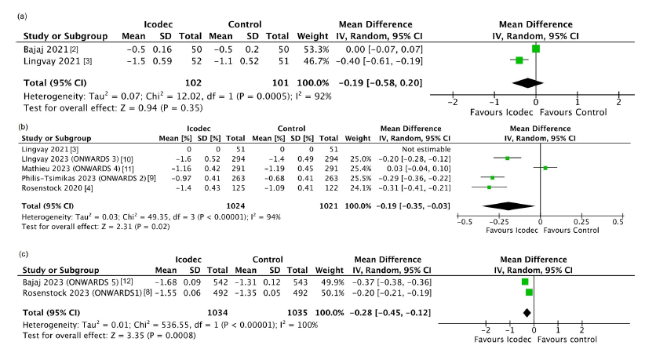
Forest plot highlighting the impact of insulin icodec as compared to control on lowering HbA1c
16-week
comparable
26-week
better
52-week better
Dutta, et al. Optimal use of once weekly icodec insulin in type-2 diabetes: An updated meta-analysis of phase-2 and phase-3 randomized controlled trials. Diabetes Metab Syndr. 2023;17(10):102877. doi: 10.1016/j.dsx.2023.102877.

Slide 15
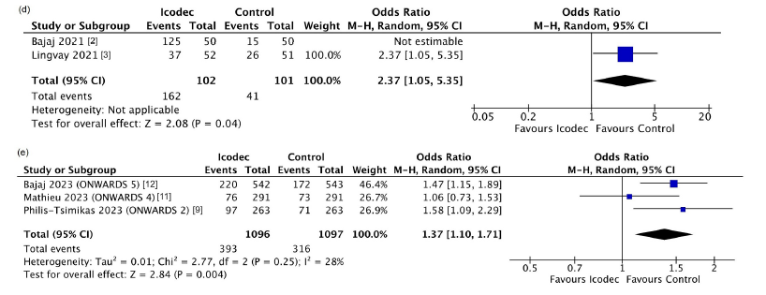
Forest plot highlighting the impact of insulin icodec as compared to control on percentage of participants achieving HbA1c <7% without level 2 or 3 hypoglycemia
26-week
higher
52-week
higher
Dutta, et al. Optimal use of once weekly icodec insulin in type-2 diabetes: An updated meta-analysis of phase-2 and phase-3 randomized controlled trials. Diabetes Metab Syndr. 2023;17(10):102877. doi: 10.1016/j.dsx.2023.102877.

Slide 16
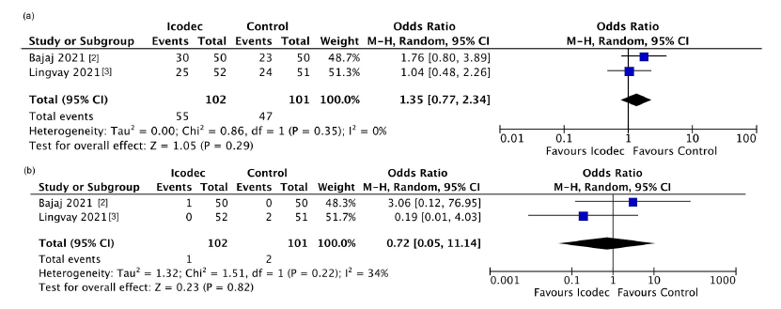
Forest plot highlighting the impact of insulin icodec as compared to control on occurrence of total and severe adverse events at 16-week
Total adverse events
similar
Severe adverse events similar
Dutta, et al. Optimal use of once weekly icodec insulin in type-2 diabetes: An updated meta-analysis of phase-2 and phase-3 randomized controlled trials. Diabetes Metab Syndr. 2023;17(10):102877. doi: 10.1016/j.dsx.2023.102877.

Slide 17
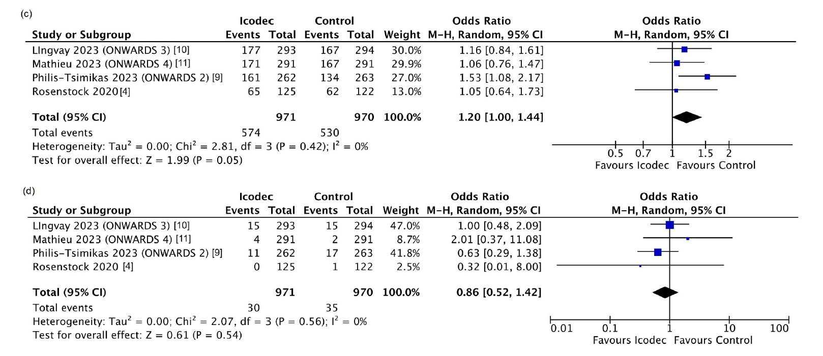
Forest plot highlighting the impact of insulin icodec as compared to control on occurrence of total and severe adverse events at 26-week
Total adverse events
similar
Severe adverse events similar
Dutta, et al. Optimal use of once weekly icodec insulin in type-2 diabetes: An updated meta-analysis of phase-2 and phase-3 randomized controlled trials. Diabetes Metab Syndr. 2023;17(10):102877. doi: 10.1016/j.dsx.2023.102877.

Slide 18
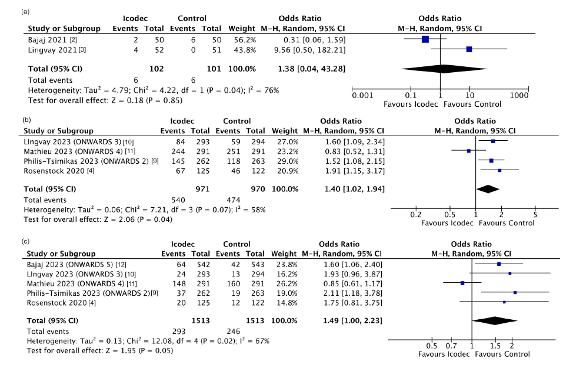
Forest plot highlighting the impact of insulin icodec as compared to control on occurrence of hypoglycemia-1
16-week
level 2 hypoglycemia similar
26-week
level 1 hypoglycemia higher
26-week
level 2 hypoglycemia
similar
Dutta, et al. Optimal use of once weekly icodec insulin in type-2 diabetes: An updated meta-analysis of phase-2 and phase-3 randomized controlled trials. Diabetes Metab Syndr. 2023;17(10):102877. doi: 10.1016/j.dsx.2023.102877.

Slide 19
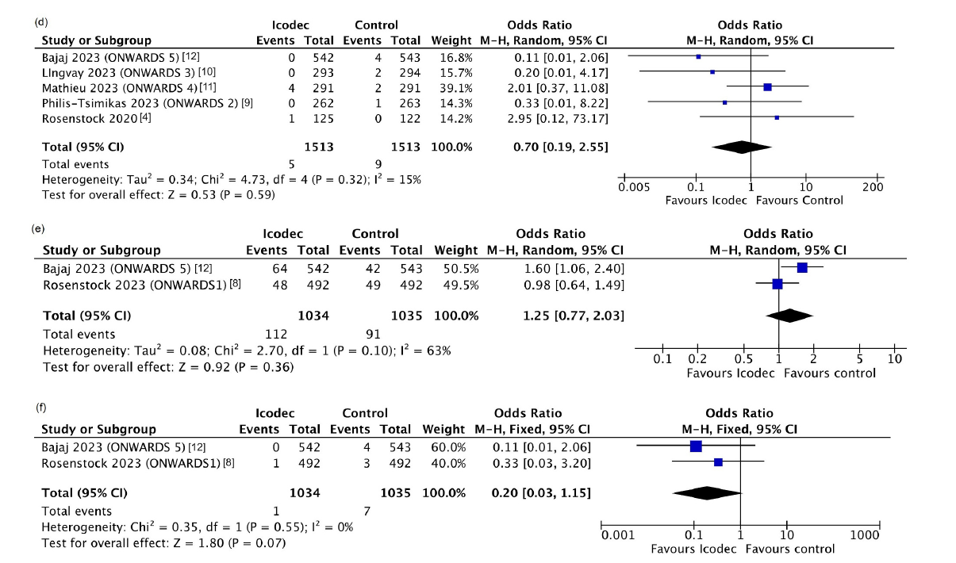
Forest plot highlighting the impact of insulin icodec as compared to control on occurrence of hypoglycemia-2
26-week
level 3 hypoglycemia similar
52-week
level 2 hypoglycemia similar
52-week
level 3 hypoglycemia
similar
Dutta, et al. Optimal use of once weekly icodec insulin in type-2 diabetes: An updated meta-analysis of phase-2 and phase-3 randomized controlled trials. Diabetes Metab Syndr. 2023;17(10):102877. doi: 10.1016/j.dsx.2023.102877.

Slide 20
Summary of findings of the major outcomes: systematic review (8 RCTs)
At 26-weeks, injection-site reactions was higher with icodec.
Subset analysis revealed increased occurrence of level-1 and level-2 hypoglycaemia in participants who received one-time additional 50 % icodec loading dose as compared to those who did not.
At 26-weeks, weight gain was significantly higher with icodec.
Dutta, et al. Optimal use of once weekly icodec insulin in type-2 diabetes: An updated meta-analysis of phase-2 and phase-3 randomized controlled trials. Diabetes Metab Syndr. 2023;17(10):102877. doi: 10.1016/j.dsx.2023.102877.

Slide 21
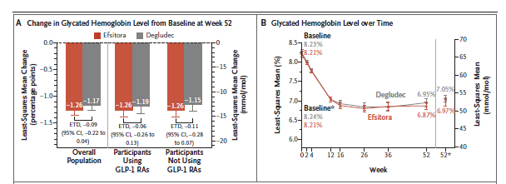
Efficacy outcomes: Once-weekly Efsitora vs. once-daily Degludec:
Change in HbA1c
Wysham, et al; QWINT-2 Investigators. Insulin efsitora versus degludec in type 2 diabetes without previous insulin treatment. N Engl J Med. 2024, Sep 10. doi: 10.1056/NEJMoa2403953. Epub ahead of print.
Notes:
Figure 1. Efficacy Outcomes among Participants Who Received Once-Weekly Efsitora or Once-Daily Degludec.
Panel A shows the least-squares mean (LSM) change in the glycated hemoglobin level from baseline at week 52 (treatment-regimen estimand)
in the overall population and among participants using and not using glucagon-like peptide-1 receptor agonists (GLP-1 RAs). The
values within the shaded bars and the estimated treatment differences (ETDs) are shown in percentage points; P<0.001 for noninferiority
for all comparisons. Error bars indicate 95% confidence intervals. Panel B shows the LSM glycated hemoglobin level over time (efficacy
estimand). The asterisk (*) indicates LSM values from the treatment-regimen estimand. Panel C shows the LSM percentage of time
spent at various glucose levels as measured by continuous glucose monitoring at baseline and weeks 48 through 52 (efficacy estimand).
Percentages may not total 100 because of rounding. Panel D shows the LSM fasting blood glucose level measured by participant-monitored
blood glucose tests over time (efficacy estimand). Fasting blood glucose values were obtained from records with “on wakening
(fasting)” confirmed or the first reading between 5 a.m. and 10 a.m. The delta symbol (Δ) indicates the LSM change from baseline to
week 52. Panel E shows the LSM insulin dose over time (efficacy estimand). In Panels B, D, and E, the I bars indicate 95% confidence
intervals; the widths of the confidence intervals were not adjusted for multiplicity. To convert values for glucose to millimoles per liter,
multiply by 0.05551. CI denotes confidence interval.

Slide 22
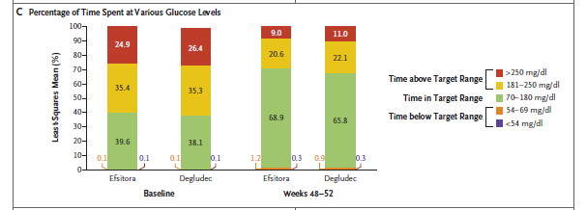
Efficacy outcomes: Once-weekly Efsitora vs. once-daily Degludec:
Time in glycemic ranges
Wysham, et al; QWINT-2 Investigators. Insulin efsitora versus degludec in type 2 diabetes without previous insulin treatment. N Engl J Med. 2024, Sep 10. doi: 10.1056/NEJMoa2403953. Epub ahead of print.

Slide 23
Efficacy outcomes: Once-weekly Efsitora vs. once-daily Degludec:
FPG and Insulin dose
Wysham, et al; QWINT-2 Investigators. Insulin efsitora versus degludec in type 2 diabetes without previous insulin treatment. N Engl J Med. 2024, Sep 10. doi: 10.1056/NEJMoa2403953. Epub ahead of print.

Slide 24
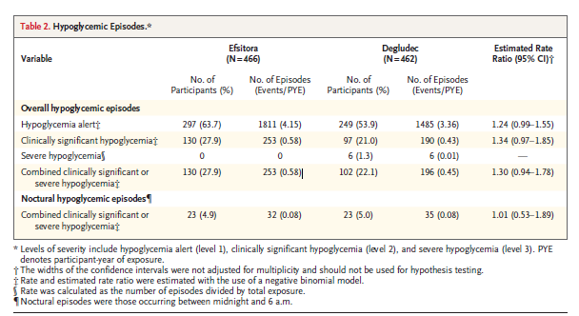
Hypoglycemia: Once-weekly Efsitora vs. Once-daily Degludec: FPG and Insulin dose
Wysham, et al; QWINT-2 Investigators. Insulin efsitora versus degludec in type 2 diabetes without previous insulin treatment. N Engl J Med. 2024, Sep 10. doi: 10.1056/NEJMoa2403953. Epub ahead of print.

Slide 25
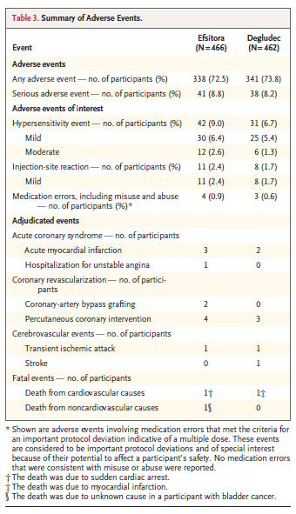
Adverse events: Once-weekly Efsitora vs. once-daily Degludec: FPG and Insulin dose
Wysham, et al; QWINT-2 Investigators. Insulin efsitora versus degludec in type 2 diabetes without previous insulin treatment. N Engl J Med. 2024, Sep 10. doi: 10.1056/NEJMoa2403953. Epub ahead of print.

Slide 26
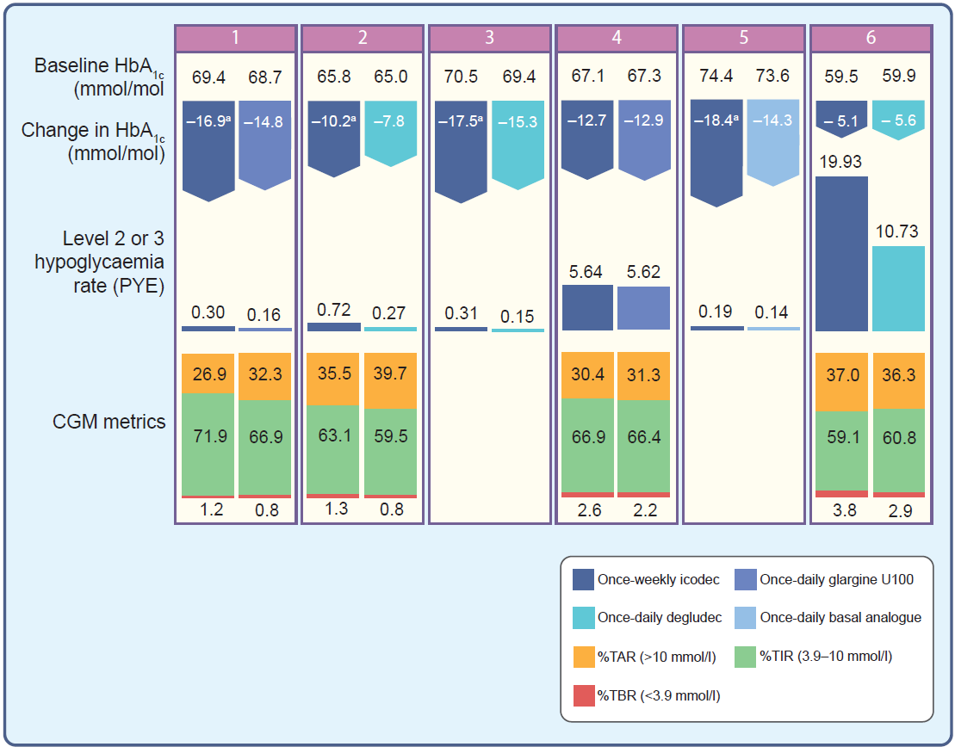
Main results of the phase-III ONWARDS 1–6 trials of once-weekly icodec vs. once-daily glargine, degludec or a basal analogue in type 1 and type 2 diabetes
Trevisan, et al. Once-weekly insulins: a promising approach to reduce the treatment burden in people with diabetes. Diabetologia. 2024;67(8):1480-92. doi: 10.1007/s00125-024-06158-9.
Notes:
Main results of the Phase III ONWARDS programme evaluating the safety and efficacy of once-weekly icodec compared with once-daily glargine, degludec or a basal analogue in individuals with type 1 and type 2 diabetes.
The numbers at the top of the figure correspond to the different ONWARDS trials (1–6 [29,30,31,32,33,34]).
Features of the study populations included are shown in Table 2.
ONWARDS 6 [34] included participants with type 1 diabetes. ªStatistically significant for superiority. TAR, time above range; TBR, time below range

Slide 27
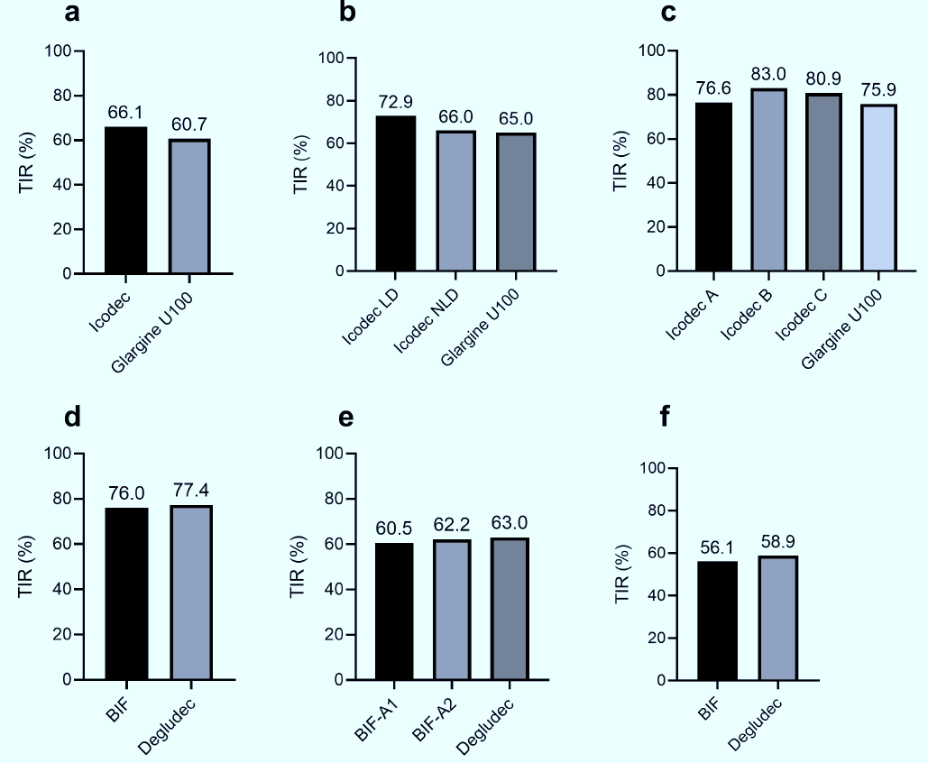
Proportion of time in range (TIR) in Phase-II clinical trials conducted with icodec (a–c) and BIF (efsitora-α) (d–f)
Icodec
Efsitora-α
Trevisan, et al. Once-weekly insulins: a promising approach to reduce the treatment burden in people with diabetes. Diabetologia. 2024;67(8):1480-92. doi: 10.1007/s00125-024-06158-9.

Slide 28
Summary
Over the last 25 years, long-acting soluble once-daily basal insulin analogues have improved the efficacy and safety of treatment compared to earlier insulin formulations
Despite availability of once-daily insulins, adherence and persistence on therapy are lower than desired
Once-weekly insulins with a flat pharmacokinetic profile could reduce the injection burden and glycemic variability, which may translate to better adherence and persistence to insulin treatment
Insulin icodec, an acylated insulin analogue, and insulin efsitora-α, an Fc-fused insulin receptor agonist, are in late-stage clinical development as once-weekly insulins
Available clinical data from insulin icodec and insulin efsitora-α show comparable glycemic control to once-daily analogues with a generally similar risk of hypoglycemia
Education around the new dosing regimens for once-weekly insulins will be needed to facilitate safe and effective use of these molecules
Notes:
Compared to earlier insulin formulations

Slide 29
Therapeutic advances of insulin therapy
Aggressive weight loss strategies together with the new glucose-lowering drugs which do not cause hypoglycemia nor weight gain should limit the number of patients with type 2 diabetes needing insulin.
Adding new oral glucose-lowering drugs to insulin such as DPP-4is lead to a modest HbA1c reduction without weight gain and no increase in hypoglycemia.
When SGLT-2is are added instead, there is a slightly higher HbA1c reduction, but with weight and BP reduction. The downside is the increase in genital tract infections.
GLP-1 RAs have become the best alternative when basal insulin fails, particularly using fixed ratio combinations (IDeg-Lira, IGlar-Lixi, Ico-Sema).
Inhaled insulins may also become an alternative for insulin supplementation and/or intensification.
“Smart insulins” are underway and may become available for clinical use in the near future.
Because of therapeutic inertia and the progressive nature of the disease, many need at least a basal insulin supplementation and insulin analogs are the best choice as they become more affordable.

Slide 30
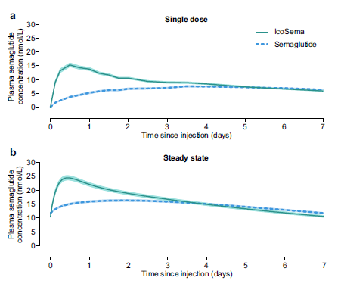
Mean plasma semaglutide concentration-time profiles
during a dosing interval of 1 week following subcutaneous injection of IcoSema (175 U [1050 nmol] insulin icodec/0.5 mg [121.5 nmol] semaglutide) or semaglutide alone (0.5 mg
[121.5 nmol]).
a. After a single dose and
b. Simulation of once weekly administration at steady
state.
n= 30 for IcoSema and
n= 28 for semaglutide.
Error bands show standard error of the mean
Westergaard et al. Pharmacokinetic properties of a once-weekly fixed-ratio combination of insulin icodec and semaglutide compared with separate administration of each component in individuals with type 2 diabetes mellitus. Clin Drug Investig. 2024;44(11):849-61. doi: 10.1007/s40261-024-01405-8.

Slide 31
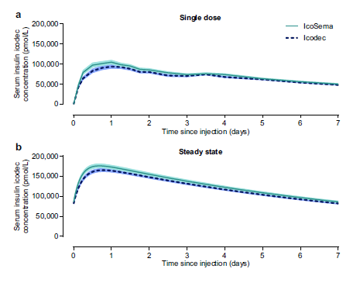
Mean serum insulin icodec concentration-time profiles
during a dosing interval of 1 week following subcutaneous injection of IcoSema (175 U [1050 nmol] insulin icodec/0.5 mg [121.5 nmol] semaglutide) or insulin icodec alone (175 U [1050 nmol]).
a. After a single dose and
b. Simulation of once weekly administration at steady state.
n= 30 for IcoSema,
n= 28 for insulin icodec
Error bands show standard error of the mean
Westergaard et al. Pharmacokinetic properties of a once-weekly fixed-ratio combination of insulin icodec and semaglutide compared with separate administration of each component in individuals with type 2 diabetes mellitus. Clin Drug Investig. 2024;44(11):849-61. doi: 10.1007/s40261-024-01405-8.

Slide 32
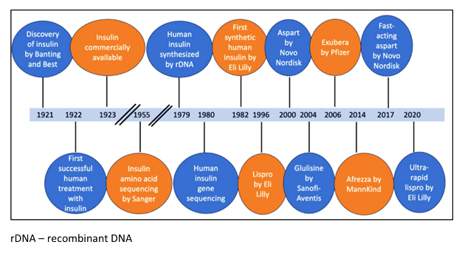
Timeline of development of prandial insulin
Attri et al. Prandial insulins: a patient-centered choice.
Current Diabetes Reports. 2024;24:131–45. doi: 10.1007/s11892-024-01540-8.

Slide 33
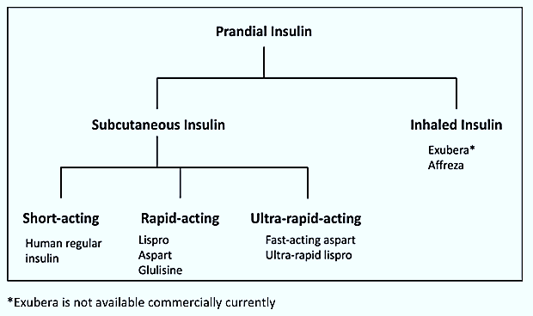
Classification of development of prandial insulin
Attri et al. Prandial insulins: a patient-centered choice.
Current Diabetes Reports. 2024;24:131–45. doi: 10.1007/s11892-024-01540-8.

Slide 34
Ultra‑rapid‑acting insulin analogs – Insulin aspart
Newer class of insulin characterized by an onset of action that is 5–10 min faster and providing greater meal-time flexibility are now available in the form of faster-acting insulin aspart or faster aspart (Fiasp®) and insulin lispro-aabc or URLi (Lyumjev®).
Faster aspart contains two additional excipients L-arginine and niacinamide to improve stability and enhance absorption from s.c..
Faster aspart appears in bloodstream earlier (2.5 vs 5.2 min) and reaches max. insulin concentration sooner (63 vs 70.3 min) than aspart.
Its onset of action is faster by 5 min and the peak effect occurs at 1.5–2.2 h which is 10 min earlier than aspart.
The duration of action is comparable (3–5 vs 5 h) though the offset of glucose-lowering was 14.3 min earlier.
The PK and PD properties of faster aspart exhibit a leftward shift across all age groups with T1DM and are effective within a broad dose range.
This insulin showed equivalent efficacy even when injected 20 min after meals.
Wong & Kroon. Ultra-rapid-acting insulins: how fast is really needed? Clin Diabetes. 2021;39:415–23;
Davis et al. Faster insulin aspart: a new bolus option for diabetes mellitus. Clin Pharmacokinet. 2019;58:421–30.

Slide 35
Ultra‑rapid‑acting insulin analogs – Lispro-aabc (URLi)
Lispro-aabc or URLi is structurally identical to lispro but the absorption from s.c. is facilitated by two additional excipients, citrate and treprostinil [63].
Treprostinil, a prostacyclin analog, enhances absorption through local vasodilation, while citrate boosts absorption by improving local vascular permeability [105].
A pooled analysis has shown a 5-min faster onset of appearance and a 43% reduction in exposure beyond 3 h when compared to lispro across all study populations and dose ranges.
In PD, URLi exhibits a 10-min faster onset of action, a 3-fold greater insulin effect within the first 30 min, and a 35% reduction in insulin action beyond 4 h when compared to lispro.
These characteristics have been consistently observed in several RCTs involving a diverse range of study populations.
Heise et al. What is the value of faster acting prandial insulin? Focus on ultra rapid lispro. Diabetes Obes Metab. 2022;24:1689–701;
Shiramoto M, Nasu R, Oura T, Imori M, Ohwaki K. Ultra-Rapid Lispro results in accelerated insulin lispro absorption and faster early insulin action in comparison with Humalog® in Japanese patients with type 1 diabetes. J Diabetes Investig. 2020;11:672–80.

Slide 36
Inhaled insulins – Technosphere insulin (Afrezza®)
Injections poses a significant hurdle to insulin therapy, prompting exploration of non-invasive delivery options.
In 2006, Exubera® is the first inhaled insulin, utilizing a dry powder formulation. Despite its faster onset of action and similar effectiveness in managing PPG compared to regular insulin, it was withdrawn from the market after 1 year due to high costs, limited labeling, inconvenient inhaler device, challenges with dose adjustments, persistent cough, and concerns about long-term safety.
Technosphere Insulin (Afrezza®) is the sole inhaled insulin option commercially. Approved by the FDA in 2014, Afrezza® is a powdered formulation of technosphere.
PK, Technosphere insulin is faster than human regular insulin and rapid-acting analogs, with a median time to max. concentration of 12–15 min, even in smokers or those with COPD. In asthmatic subjects, insulin absorption may be reduced.
In glucose clamp studies, peak glucose-lowering activity occurs at 53 min, with a duration of action lasting 2.5–3 h.
Afrezza® demonstrates similar A1c reduction and a trend towards better PPG control with a lower risk of late post-meal (4–6 h) hypoglycemia when compared to aspart and lispro. A few studies showed less weight gain with Afrezza® compared to rapid analogs.
Adverse events: cough, throat pain, and irritation. Afrezza® is not recommended for individuals with. Baseline assessment and regular monitoring of pulmonary function first at 6-month, and then annually are recommended.
Pooled data from studies involving >5000 individuals have shown a slight, reversible decline in pulmonary function from baseline.
Klonoff. Afrezza Inhaled Insulin. J Diabetes Sci Technol. 2014;8:1071–3; Kruger, et al. Recognition of and steps to mitigate anxiety and fear of pain in injectable diabetes treatment. Diabetes Metab Syndr Obes. 2015;8:49–56; Mikhail. Safety of technosphere inhaled insulin. Curr DrugSaf. 2017;12:27–31; McGill, et al. Comprehensive pulmonary safety review of inhaled Technosphere® insulin in patients with diabetes mellitus. Clin Drug Investig. 2020;40:973–83.

